Slide 1
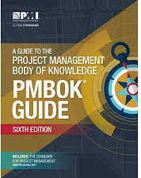
Software Project Management
6th Edition
Lecture 3
PM Knowledge Areas
Project Management Institute

Slide 2
PMI
PMI stands for the Project Management Institute, and is a not-for-profit professional membership association for project managers and program managers.
PMI was started in 1969, and now has a membership of more than 2.9 million professionals around the globe.
The Project Management Institute is the organization that gives out the PMP (Project Management Professional) credential, a globally recognized certificate that assures employers that a person is trained and qualified to manage projects.
PMI is also the organization that oversees the documentation of the Project Management Body of Knowledge (PMBOK) within the PMBOK Guide.

Slide 3
PMBOK
PMBOK stands for Project Management Body of Knowledge .
It is the entire collection of processes, best practices, terminologies, and guidelines that are accepted as standards within the project management industry.
Because the body of knowledge is constantly growing as practitioners discover new methods or best practices, it must be updated and disseminated.
This is an effort that is overseen by the Project Management Institute (PMI), the global not-for-profit member association of PM professionals which captures and publishes the PMBOK within the book, A Guide to the Project Management Body of Knowledge (PMBOK Guide).
The first edition of the PMBOK Guide was published in 1996. It is now on its sixth edition, which was published in 2017.
Notes:
49 processes, 10 knowledge areas

Slide 4
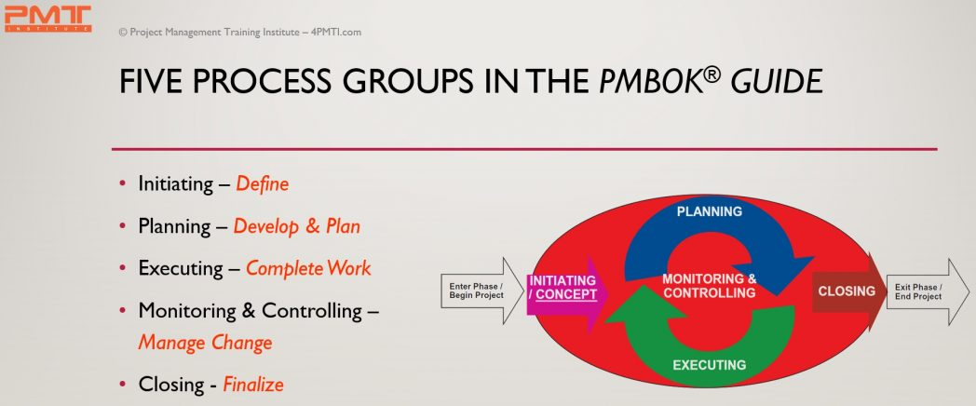
PMBOK Process Groups
Notes:
A process is a series of actions directed toward a particular result
Process groups and their constituent processes are guides for applying appropriate project management knowledge and skills during the project.’

Slide 5
PMBOK Process Groups
The initiating process group consists of processes necessary to define a new project or a new phase of an existing project
Involves obtaining authorization for the project or project phase
Defines objectives, outcomes, and success criteria
Assigns a Project Manager (usually)
Allocates funds and resources

Slide 6
PMBOK Process Groups
There are several key outputs that are produced as part of the initiation process group. These are the:
Project Charter
Feasibility Study
Stakeholder-related documents (stakeholder list, stakeholder management plan).

Slide 7
PMBOK Process Groups
The planning process group involves
Defining the scope of the project
Designing the course of action required to achieve the project’s objectives
Defining the products to be produced and work required
Sequencing work and creating a schedule
Estimating the resource and effort requirements
Estimating costs and creating a budget

Slide 8
PMBOK Process Groups
The key outputs of the planning process group are the
Project Management Plan
Work Breakdown Structure (WBS)
Schedule
Budget

Slide 9
PMBOK Process Groups
The executing process group involves:
Establishing and managing the project team
Coordinating people and resources
Monitoring team performance
Contracting procurements
Directing and managing project execution
Distributing information
Performing quality assurance activities

Slide 10
PMBOK Process Groups
The main outputs of this process group are:
The risk and issue management responses plus corrective and preventative actions
The deliverables themselves plus work performance information
Change requests with regards to utilization and effectiveness of the quality plan
Negotiation and influence to ensure appropriate staff are assigned
Motivation building and mentoring to ensure the team performance
Conflict resolution and problem solving
Procurements and contracts are negotiated and put in place

Slide 11
PMBOK Process Groups
The Monitoring & Controlling Process Group
Involves tracking, reviewing, and regulating project progress
Includes status reporting, progress measurement, and forecasting
Reports on scope, schedule, cost, resources, quality, and risks
Controls project and project document changes Includes control of scope, schedule, costs, and risks
Records quality control results
Implements risk treatment plans and actions
Administers procurements

Slide 12
PMBOK Process Groups
The key outputs are
Progress and status reports
Plan updates
Risks registers
Change requests
Work products/deliverables

Slide 13
PMBOK Process Groups
The key activities for the closing process group are
Obtaining acceptance by the customer or sponsor (approval to close)
Releasing people and resources
Reporting on team performance and lessons learned
Updating or finalizing documents, project records, and results
Finalizing procurements
Performing quality assurance activities
Storing or archiving information

Slide 14
PMBOK Process Groups
The key outputs of this group are
Certificate of Completion/Closeout Report
Staff work assignments
Resource calendars
Plan updates
Final work products/deliverables or services

Slide 15
PMBOK Knowledge Areas
The ten knowledge areas are the skills a project manager must practice and master to manage a project efficiently.
Main activities of each process group can be mapped into the Ten knowledge areas using the PMBOK® Guide 2017.

Slide 16
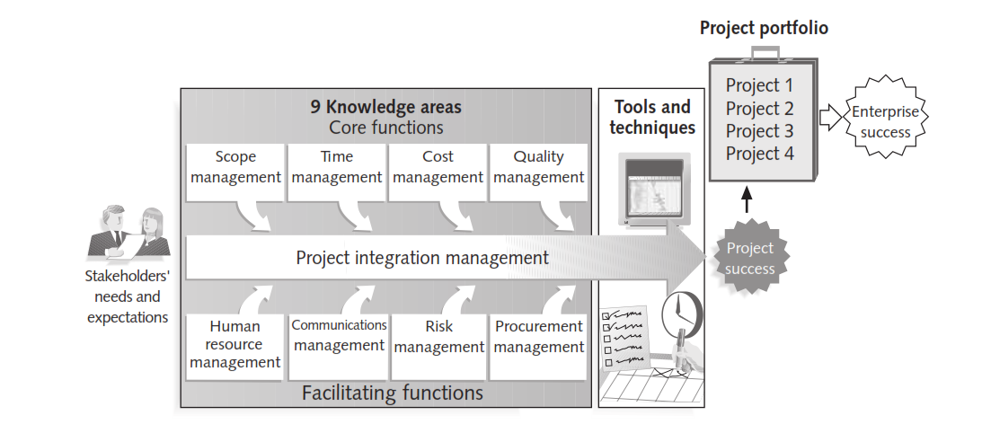
PMI Knowledge Areas
Project Management Knowledge Area: An identified area of project management defined by its knowledge requirements and described in terms of its component processes, practices, inputs, outputs, tools, and techniques.
Notes:
Project Managers must not only strive to meet specific scope, time, cost and quality goals of projects, they must also facilitate the entire process to meet the needs and expectations of the people involved in or effected by project activities.

Slide 17
Overview of Knowledge Areas
Scope
Integration
Human Resources
Communications
Risk
Procurement
Stakeholder management
Cost
Time
Quality

Slide 18
PMBOK Knowledge Areas
Project Integration Management:
The knowledge area which is devoted to identify and define the work in the project is known as the Integration Management.
This knowledge area also deals with efficiently integrating changes into the project.
Includes the processes and activities to identify, define, combine, unify, and coordinate the various processes and project management activities within the Project Management Process Groups.

Slide 19
PMBOK Knowledge Areas
Project Integration Management:
The project Integration management processes are:
Develop Project Charter—The process of developing a document that formally authorizes the existence of a project and provides the project manager with the authority to apply organizational resources to project activities.
Develop Project Management Plan—The process of defining, preparing, and coordinating all subsidiary plans and integrating them into a comprehensive project management plan.
Direct and Manage Project Work—The process of leading and performing the work defined in the project management plan and implementing approved changes to achieve the project's objectives.
Monitor and Control Project Work—The process of tracking, reviewing, and reporting project progress against the performance objectives defined in the project management plan.
Perform Integrated Change Control—The process of reviewing all change requests; approving changes and managing changes to deliverables, organizational process assets, project documents, and the project management plan; and communicating their disposition.
Close Project or Phase—The process of finalizing all activities across all of the Project Management Process Groups to formally complete the phase or project.

Slide 20
PMBOK Knowledge Areas
Project Scope Management
This knowledge area deals with defining the project scope, project requirement scope, project work, making the work breakdown structure, making the scope baselines and managing the scope of the project.
This is one point where you can plan the ways of keeping the project within the established boundaries.
Encompasses the processes required to ensure the project includes all the work required, and only the work required, to complete the project successfully.
Notes:
This process is essential to ensure that the project includes all the necessary work while excluding any unnecessary work.
A scope baseline is an approved version of your project scope, which is documented in a scope statement, work breakdown structure (WBS) and WBS dictionary.
The scope baseline is used as a reference to monitor project progress and compare actual versus planned results.
A WBS dictionary is where the details of the tasks, activities, and deliverables of the work breakdown structure are located.

Slide 21
PMBOK Knowledge Areas
Project Scope Management
The project scope management processes are:
Plan Scope Management—The process of creating a scope management plan that documents how the project scope will be defined, validated, and controlled.
Collect Requirements—The process of determining, documenting, and managing stakeholder needs and requirements to meet project objectives.
Define Scope—The process of developing a detailed description of the project and product.
Create WBS—The process of subdividing project deliverables and project work into smaller, more manageable components.
Validate Scope—The process of formalizing acceptance of the completed project deliverables.
Control Scope—The process of monitoring the status of the project and product scope and managing changes to the scope baseline.

Slide 22
PMBOK Knowledge Areas
Project Time Management:
The project managers estimate the duration of the tasks in this knowledge area.
This is where the project manager sequences the tasks and chooses the number of resources required to achieve the objectives of the project.
Schedule is monitored and managed here in this area to keep the project on the track.
Includes the processes required to manage the timely completion of the project.

Slide 23
PMBOK Knowledge Areas
Project Time Management:
The project time management processes are:
Plan schedule management.
Define Activities: Process of identifying and documenting the specific actions.
Sequence Activities: Process of identifying and documenting relationships.
Estimate Activity Resources: Process of estimating the type and quantities of material, human resources, equipment, or supplies.
Estimate Activity Durations: Process of estimating the number of work periods.
Develop Schedule: Process of analyzing activity sequences, durations, resource requirements, and schedule constraints.
Control Schedule: Process of monitoring the status of project activities.

Slide 24
PMBOK Knowledge Areas
Project Cost Management:
Budget baseline is established and costs are estimated in this knowledge area.
The plan to manage the costs is categorized in the cost management knowledge area too.
Includes the processes involved in planning, estimating, budgeting, financing, funding, managing, and controlling costs so the project can be completed within the approved budget.

Slide 25
PMBOK Knowledge Areas
Project Cost Management:
The project cost management processes are:
Plan Cost Management—The process that establishes the policies, procedures, and documentation for planning, managing, expending, and controlling project costs.
Estimate Costs—The process of developing an approximation of the monetary resources needed to complete project activities.
Determine Budget—The process of aggregating the estimated costs of individual activities or work packages to establish an authorized cost baseline.
Control Costs—The process of monitoring the status of the project to update the project costs and managing changes to the cost baseline.

Slide 26
PMBOK Knowledge Areas
Project Quality Management:
It is the knowledge area where the quality requirements for project deliverables are planned and tracked.
In this area, all the quality issues are monitored and fixed.
Includes the processes for incorporating the organization's quality policy regarding planning, managing, and controlling project and product quality requirements, in order to meet stakeholders’ expectations.

Slide 27
PMBOK Knowledge Areas
Project quality Management:
The project quality management processes are:
Plan Quality Management—The process of identifying quality requirements and/or standards for the project and its deliverables and documenting how the project will demonstrate compliance with quality requirements.
Perform Quality Assurance—The process of auditing the quality requirements and the results from quality control measurements to ensure that appropriate quality standards and operational definitions are used.
Control Quality—The process of monitoring and recording results of executing the quality activities to assess performance and recommend necessary changes.

Slide 28
PMBOK Knowledge Areas
Project Human Resources Management:
This knowledge area, which is the HR management of the project.
It comprises of the processes very essential to define the ways human resources will be utilized, developed, acquired and managed.
Includes the processes to identify, acquire, and manage the resources needed for the successful completion of the project.

Slide 29
PMBOK Knowledge Areas
Project human Management:
The project human management processes are:
Plan Human Resource Management—The process of identifying and documenting project roles, responsibilities, required skills, reporting relationships, and creating a staffing management plan.
Acquire Project Team—The process of confirming human resource availability and obtaining the team necessary to complete project activities.
Develop Project Team—The process of improving competencies, team member interaction, and overall team environment to enhance project performance.
Manage Project Team—The process of tracking team member performance, providing feedback, resolving issues, and managing changes to optimize project performance.

Slide 30
PMBOK Knowledge Areas
Project Communications Management:
Communications management is the knowledge area that defines how communications within the project will work.
In these processes, the project manager makes the communication management plan, ensures the plan is followed, and controls information flow within the project.
Includes the processes required to ensure timely and appropriate planning, collection, creation, distribution, storage, retrieval, management, control, monitoring, and ultimate disposition of project information.

Slide 31
PMBOK Knowledge Areas
Project Communications Management:
The project Communications management processes are:
Plan Communications Management—The process of developing an appropriate approach and plan for project communications based on stakeholder's information needs and requirements, and available organizational assets.
Manage Communications—The process of creating, collecting, distributing, storing, retrieving and the ultimate disposition of project information in accordance with the communications management plan.
Control Communications—The process of monitoring and controlling communications throughout the entire project life cycle to ensure the information needs of the project stakeholders are met.

Slide 32
PMBOK Knowledge Areas
Project Risk Management:
Project Risk Management consists of identifying risks, planning risk management, conducting risk assessments, and controlling risks.
Project Risk Management includes the processes of conducting risk management planning, identification, analysis, response planning, response implementation, and monitoring risk on a project.
Notes:
A risk response plan is a document that explains the strategies that would be taken to mitigate negative project risks.

Slide 33
PMBOK Knowledge Areas
Project Risk Management:
The project Risk management processes are:
Plan Risk Management—The process of defining how to conduct risk management activities for a project.
Identify Risks—The process of determining which risks may affect the project and documenting their characteristics.
Perform Qualitative Risk Analysis—The process of prioritizing risks for further analysis or action by assessing and combining their probability of occurrence and impact.
Perform Quantitative Risk Analysis—The process of numerically analyzing the effect of identified risks on overall project objectives.
Plan Risk Responses—The process of developing options and actions to enhance opportunities and to reduce threats to project objectives.
Control Risks—The process of implementing risk response plans, tracking identified risks, monitoring residual risks, identifying new risks, and evaluating risk process effectiveness throughout the project.

Slide 34
PMBOK Knowledge Areas
Project Procurement Management:
This knowledge area deals with the processes which project managers usually follow to acquire required material for the successful completion of the project.
In this knowledge area, project managers come up with the plan for conducting procurements, controlling the procurements and closing out the procurements.
Project Procurement Management includes the processes necessary to purchase or acquire products, services, or results needed from outside the project team.

Slide 35
PMBOK Knowledge Areas
Project Procurement Management:
The project procurement management processes are:
Plan Procurement Management—The process of documenting project procurement decisions, specifying the approach, and identifying potential sellers.
Conduct Procurements—The process of obtaining seller responses, selecting a seller, and awarding a contract.
Control Procurements—The process of managing procurement relationships, monitoring contract performance, and making changes and corrections as appropriate.
Close Procurements—The process of completing each project procurement.

Slide 36
PMBOK Knowledge Areas
Project Stakeholder Management:
Project Stakeholder Management area encompasses all the processes which is used by a project manager for recognizing and satisfying the ones who are affected by the project.
The affected party can either be internal or external, in nature.
You can pay close attention to those stakeholders who can have a powerful positive or negative impact on the project.

Slide 37
PMBOK Knowledge Areas
Project Stakeholders Management:
The project stakeholders management processes are:
Identify Stakeholders—The process of identifying the people, groups, or organizations that could impact or be impacted by a decision, activity, or outcome of the project; and analyzing and documenting relevant information regarding their interests, involvement, interdependencies, influence, and potential impact on project success.
Plan Stakeholder Management—The process of developing appropriate management strategies to effectively engage stakeholders throughout the project life cycle, based on the analysis of their needs, interests, and potential impact on project success.
Manage Stakeholder Engagement—The process of communicating and working with stakeholders to meet their needs/expectations, address issues as they occur, and foster appropriate stakeholder engagement in project activities throughout the project life cycle.

Slide 38
PMBOK Knowledge Areas
Project Stakeholder Management:
Monitoring Stakeholder Engagement - In this process, the project manager should monitor stakeholders’ relationships and tailor strategies for engaging stakeholders via modification strategies and plans. Furthermore, monitoring stakeholder engagement helps the project manager enhance the efficiency and productiveness of stakeholder engagement activities. As well as this process is performed throughout the project life cycle.

Slide 39
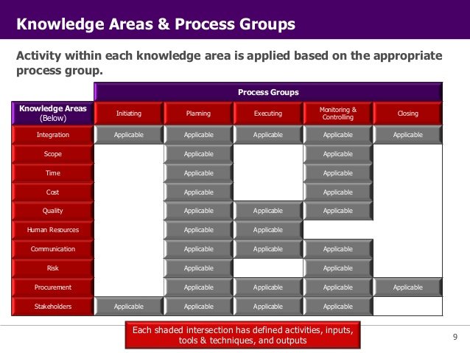
Knowledge Areas and Process Groups

Slide 40
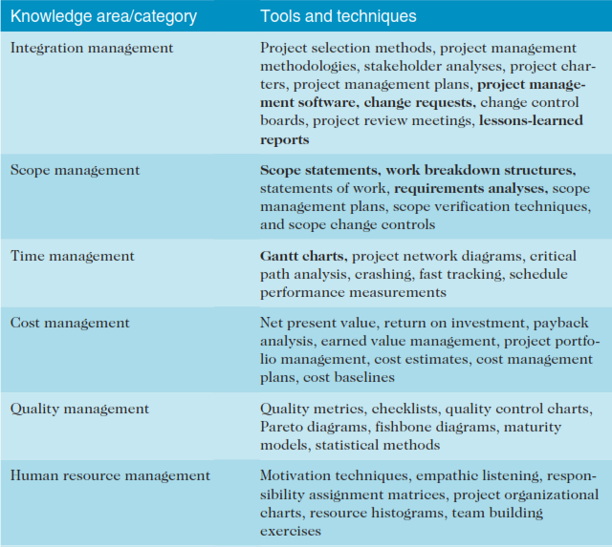
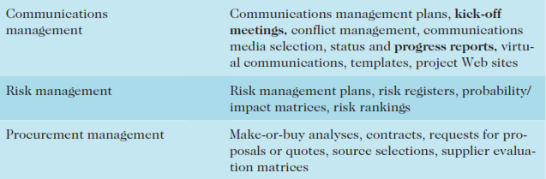
Tools & Techniques by Knowledge Area

Slide 41
The Integration Challenge Software Product Development Example
Proposal Request
Overlapped phases can yield cost and schedule benefits but add to the integration challenge
Proposal Phase
Requirements Analysis Phase
General Design Phase
Detailed Design Phase
Code and Debug

Slide 42
Characteristics of Effective Integration
Overlapped processes
Effective change control and communication systems
Reduced development time and cost
Early and ongoing involvement of all stakeholders
Early visibility of results
Early problem identification and resolution
Use all relevant expertise at earliest meaningful time

Slide 43
Project Scope Management
“Includes the processes required to ensure that the project includes all of the work required, and only the work required to complete the project successfully.”
Initiation
Scope planning
Scope definition
Scope verification
Scope change control

Slide 44
Key Scope Concepts (continued)
Work Breakdown Structure
A deliverable-oriented grouping of process elements that organizes and defines the total scope of the project
Each descending level represents an increasingly detailed definition of a project component
Project components may be products or services

Slide 45
Remodel Kitchen WBS
Remodel Kitchen
Level 1
Design
Purchase
Carpentry
Electrical
Purchase
Appliances
Purchase
Fixtures
Level 2

Slide 46
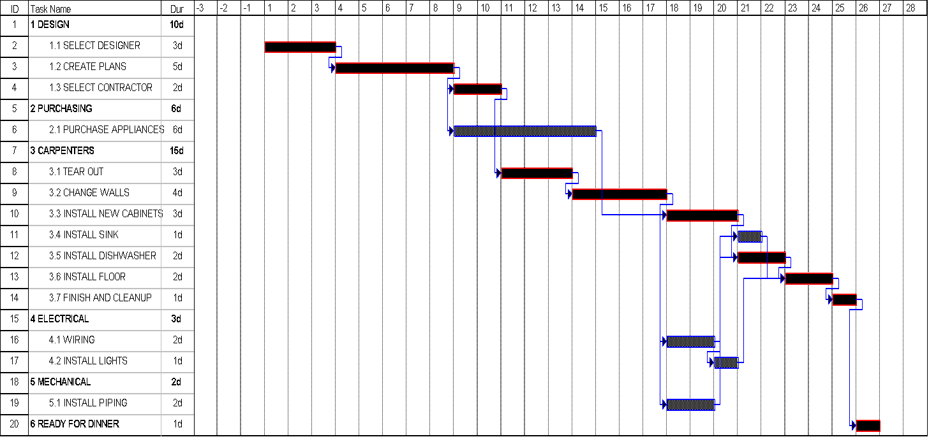
Kitchen Remodeling Precedence Relationships

